Slide 1
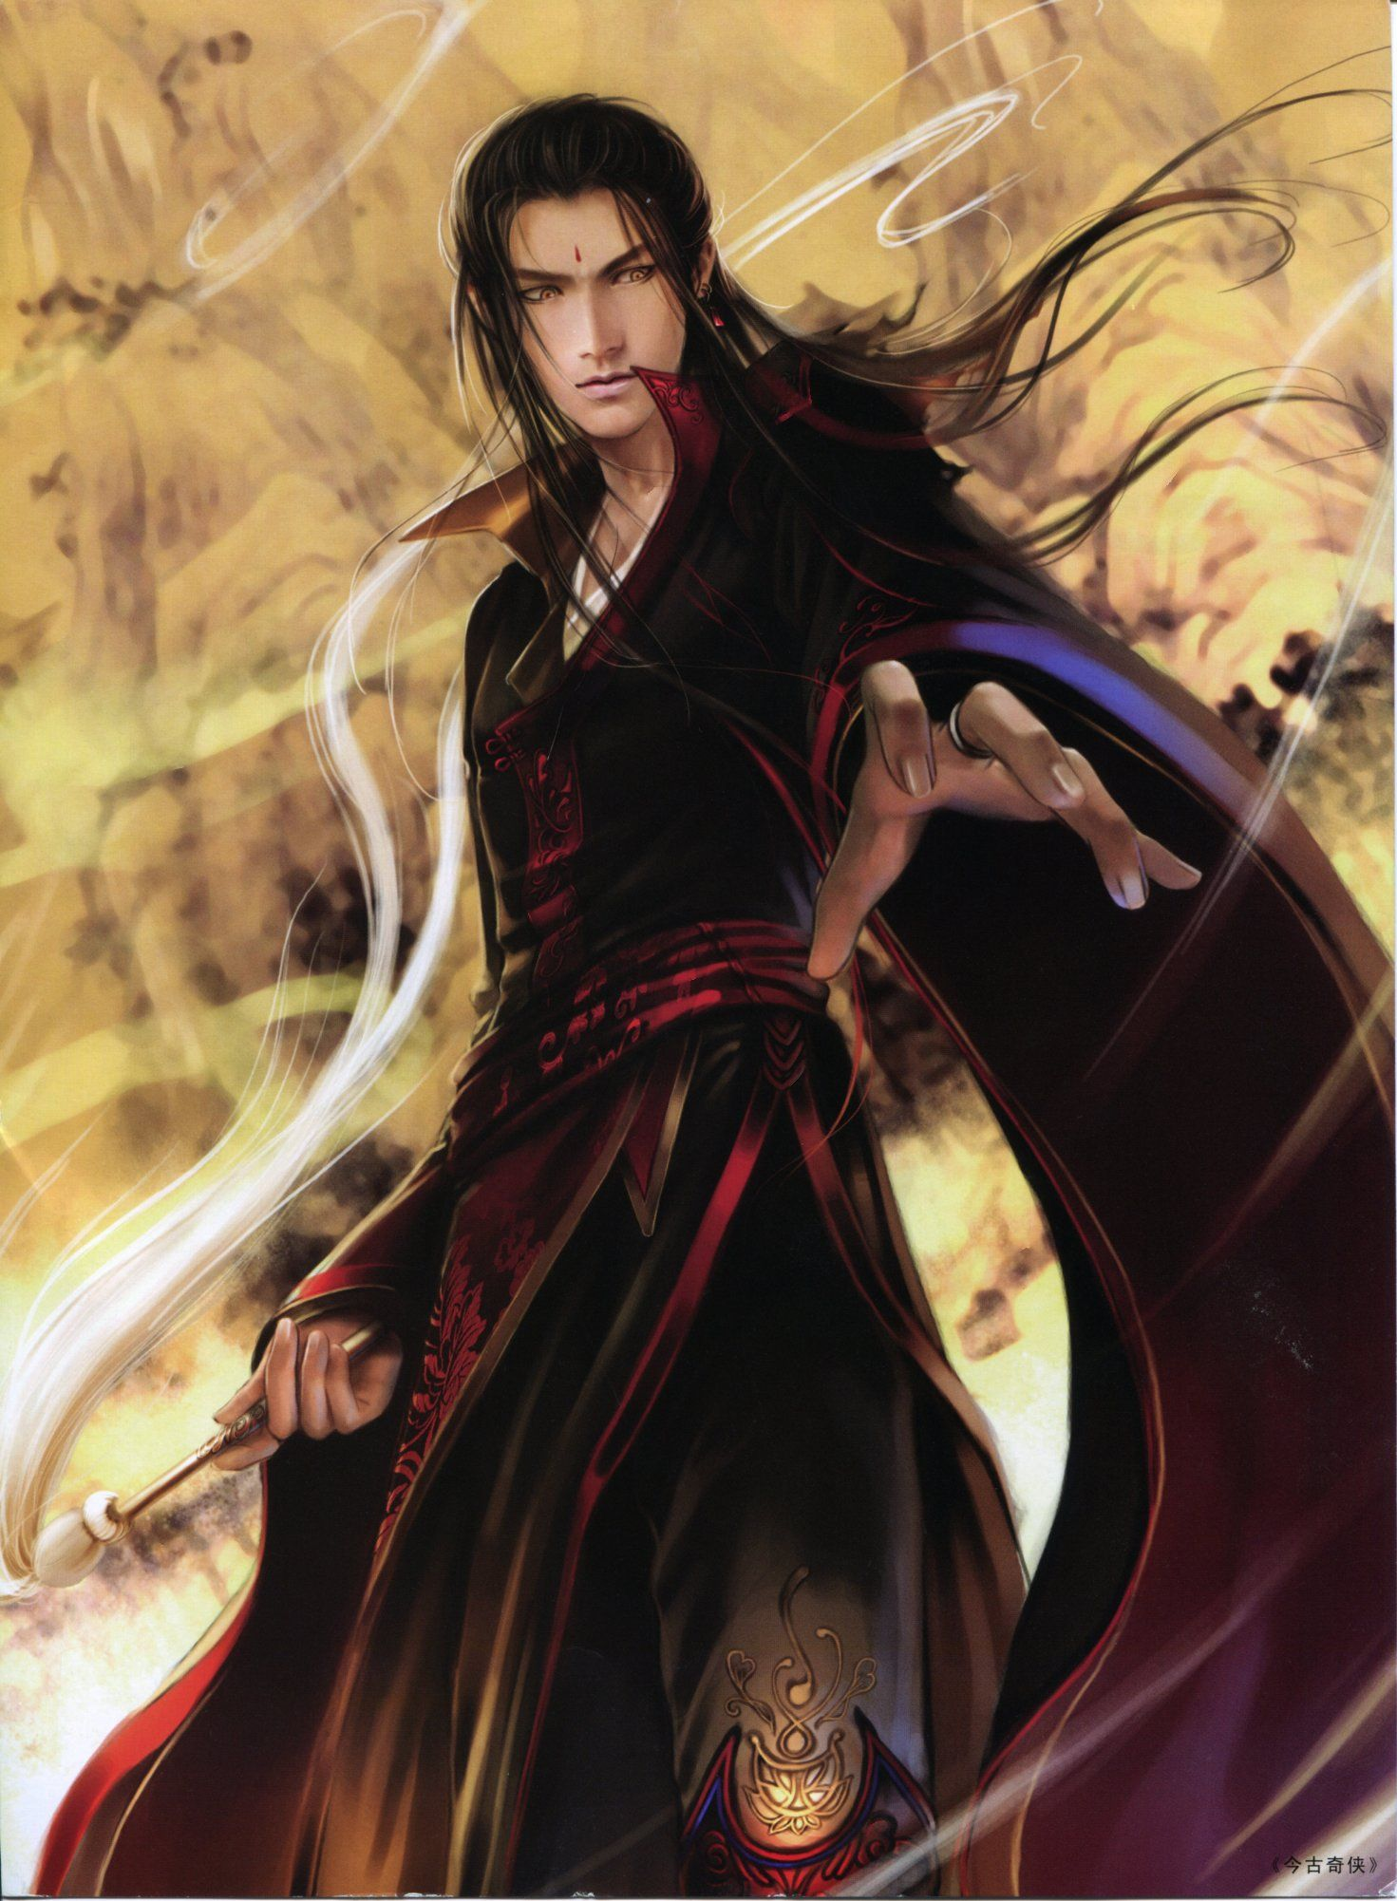
Elementalist
Haru
2
Strenght
6
Dexterity
4
Vitality
10
Magic

